Slide 1
The Pioneer of Human-Computer Interactions
By Samruddhi Tawade
stawade@purdue.edu
CGT 275

Slide 2
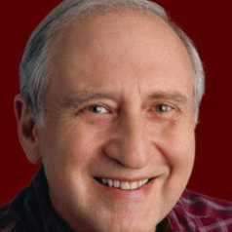
BEN SHNEIDERMAN
Professor at University of Maryland, founder of the Human-Computer Interaction Lab
Was the pioneer of highlighted textual links, which would later become hyperlinks (Hyperties)
Tim Berners Lee cited this in his Spring Manifesto, which would become the World Wide Web
Invented dynamic query sliders to filter and focus on data while visualizing
Founder of the treemap (1990) and Nassi-Shneiderman diagrams used in structured programming
Work in direct-manipulation interface led to the creation of the touchscreen keyboard
Patent for photo tagging
Ben Shniederman, 74
Member of the National Academy of Engineering, Fellow of the National Academy of Inventors. Recipient of the ACM SIGCHI Lifetime Achievement Award and the IEEE Visualization Career Award

Slide 3
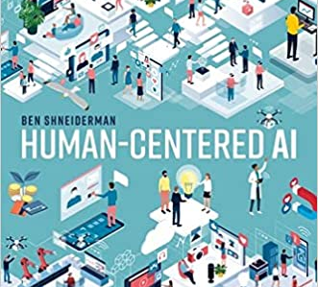
Sources:
http://www.cs.umd.edu/users/ben/
https://www.psychologytoday.com/us/blog/seeing-what-others-dont/201801/the-invention-hyperlinks
https://theconversation.com/profiles/ben-shneiderman-683519
https://analyticsindiamag.com/how-ben-shneidermans-treemaps-found-place-in-the-museum-of-modern-art/#:~:text=Treemap%2C%20a%20predominantly%20utilized%20visualization,Modern%20Art%20in%20New%20York.
https://en.wikipedia.org/wiki/Ben_Shneiderman
“Human – Centered AI” by Ben Shneiderman

Slide 4
Thank you for listening!

